Slide 1
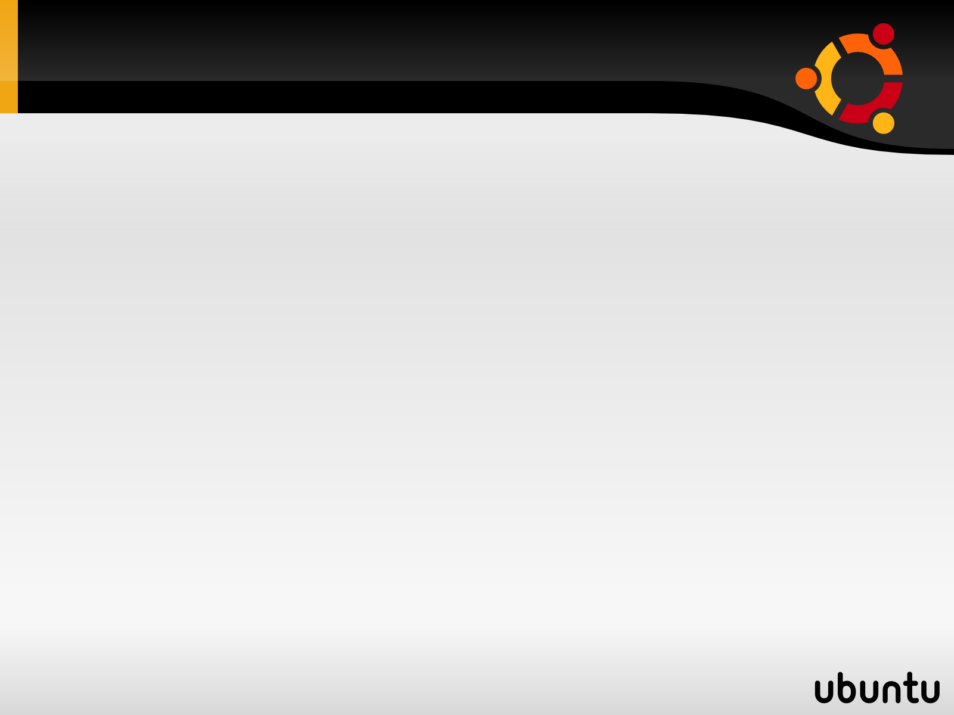
The Taxicab Network
The Taxicab Network is a taxi dispatch system consisting of taxis and a dispatcher (with controller built in).
In a standard setup, the runs on its own host (computer) and taxis run on other computers.
It is possible for the taxis and dispatcher to run on the same computer.

Slide 2
Overview and Basic Architecture
Taxis cannot start unless the controller is running.
When starting a new taxi. The user enters a patrol area (1 to 16) and the IP address to the controller (dispatcher) on the command line as follows: java Taxi 1 255.255.255.222. If no IP is entered, the default address is “localhost”.
Taxi enters service in patrol mode. It registers with the controller. The controller knows to taxi's current location.
Taxis can only move to a desired location if and only if the location is empty. Therefore the taxi must obtain permission from the controller before changing locations.
If a taxi cannot access a location within a set time, the taxi will attempt to move to a different location to avoid “jamming”.

Slide 3
Overview Continued
When a request is entered, the dispatcher first determines the area of the pickup location. If a taxi is patrolling in that area, it will be assigned the call. Otherwise, the dispatcher will search for an available taxi for the call and send it.
Flags: A patrolling taxi can be flagged. During a flag, taxi will pickup and move to the desired destination.
Taxis can only go out of service when they are patrolling.
Dispatcher (Controller) can only be shutdown if no taxis are in service.

Slide 4
System Design
Taxi is dependent on the following classes: Location, TaxiThread, TaxiUI, and DetArea.
Its network dependencies are Controller, ControllerThread, and DisControl.
Controller is dependent on DetArea, Location, DisControl, and DispatchUI.
Request is a dependency of DisControl.
Network communication is done by using Sockets (read/write) and ServerSockets (listens only).
The controller indefinitely listens on port 8000 for new taxis. The controller creates a new ControllerThread for the taxi.
ControllerThread handles location requests.
The class Taxi listens to requests from DisControl and port 8000 + id and forwards them to TaxiThread, when enables the taxi to move.

Slide 5
System Design Continued
Location is a class that stores the North-South and East-West locations It also stores a timeout counter to determine if a “jam” occurs.
Request is an object containing two location (origination and destination) it is used by the dispatcher to store requests.
To send a Location to another host via sockets, the Location is converted into a byte array and sent to the correct destination using DataInputStream (receivig) and DataOutputStream (sending). The destination converts the array back into a Location for future manipulation.
DetArea determines the area of a Location and the start location of a patrol area.

Slide 6
Design Techniques & Improvements
Due to the lack of time, this project consists of existing code from Project 1 altered for network communication.
This is why Location is converted into bytes and then converted back. This technique was used, instead of using byte arrays to Location, to reduce compile and logic errors that can occur during code change. It also eliminates the need to cast correct data types on every read and write.
Improvements: Unlike Project 1, A taxi verifies that its start patrol location is empty before claiming the area.

